Slide 1
Injury to Internal organs: Accident or Abuse?
Anne Smith VFPMS

Slide 2
Internal organ injury
Basic principles
Solid organs may lacerate and bleed
Hollow organs may rupture and leak
  Stomach, intestines, bladder, ureters + gall bladder
Bone fragments may penetrate & damage deeper tissues
Vessels in mesentery may tear resulting in large volume haemorrhage and organ ischaemia
Veins are more vulnerable to physical trauma than arteries
  Higher pressures are required to compress arteries than veins
Probably under-recognised / under-detected
Can be fatal
Overlying skin may appear uninjured

Slide 3
A brief overview
Intra-thoracic injury
Intra-abdominal trauma
Strangulation (neck trauma)

Slide 4
Intra-thoracic injury
Sternum, scapula and ribs, flail chest
Pleura and pericardium
Heart
Lungs
Mediastinal tissues (thymus)

Slide 5
Rib fractures
Children’s ribs are more pliable than adults’. Bend > break
Posterior rib fractures are highly correlated with abuse
Rib fractures are a rare complication of CPR in children (only 3 out of 923 children) all multiple and anterior, no posterior (WCPSRG Cardiff)
Can be missed on routine CXR
Mortality increases (linear) with number of ribs fractured
No breakpoint for mortality in pediatric rib fractures.
Rosenberg G, Bryant AK, Davis KA, Schuster KM J Trauma Acute Care Surg. 2016;80(3):427.

Slide 6
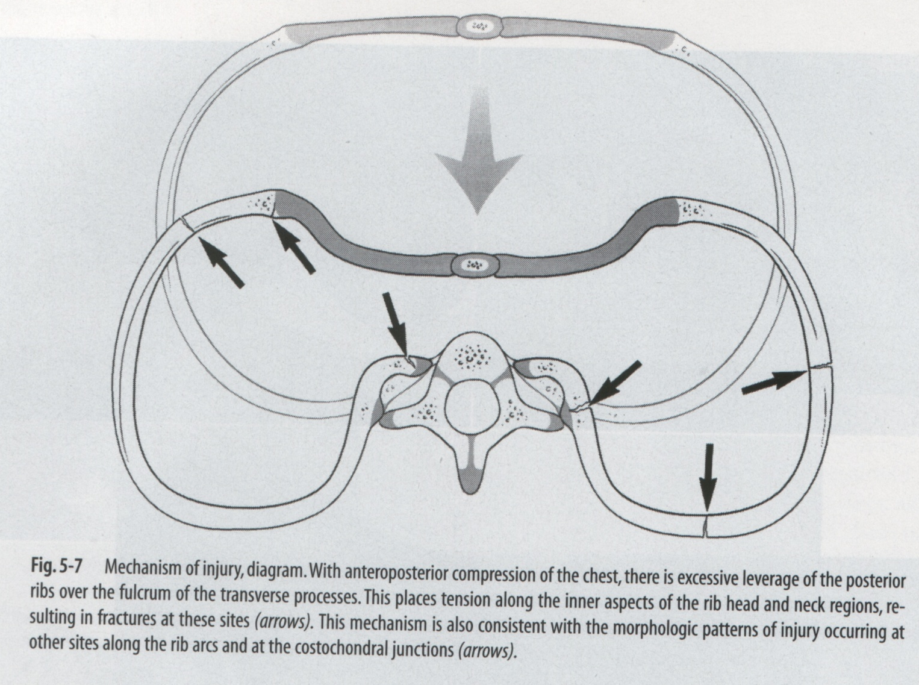
Compression & rib fractures

Slide 7
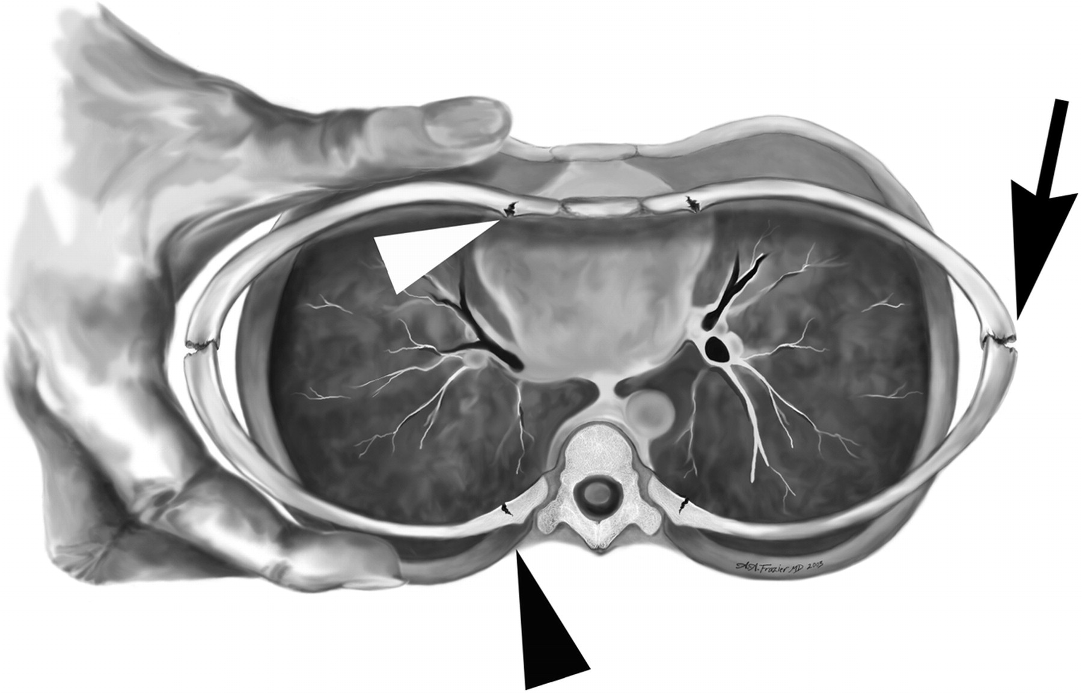
Figure 8. Rib fracture mechanism in tight squeezing
Lonergan G J et al. Radiographics 2003;23:811-845
©2003 by Radiological Society of North America
Notes:
Figure 8. Rib fracture mechanism in tight squeezing. Diagram of the midthorax during tight squeezing reveals anteroposterior compression, which causes compression and fracture of the ribs laterally (arrow). There is hyperextension of the posterior rib ends over the transverse process, with fracture of the ventral cortex (black arrowhead). Anteriorly, the chest wall compression leads to inward bending of the anterior ribs and fracture (white arrowhead).

Slide 8
Bilateral pleural effusions
Pericardial effusion
Infant also had
Liver laceration
Small amount of free fluid sub-diaphragm
Large distended gall bladder

Slide 9
A clinical decision rule for identifying children with thoracic injuries after blunt torso trauma.
Holmes JF, Sokolove PE, Brant WE, Kuppermann N
Ann Emerg Med. 2002;39(5):492
Predictors of thoracic injury in children sustaining blunt torso trauma include
low systolic blood pressure,
elevated respiratory rate,
abnormal results on thoracic examination, abnormal chest auscultation findings,
femur fracture,
and a GCS score of less than 15.

Slide 10
Intrathoracic trauma
– basic tests
CXR
Chest CT
Chest MRI (“whole body” MRI infants?)
FAST (US)
Think ABDO trauma
FBE
Clotting
O2 Saturation
Blood gas
Troponin

Slide 11
Intra-abdominal trauma
Injuries associated with NAT to anterior abdomen
Forces transmitted through anterior abdo wall – +/- external sign
Haematoma anterior abdominal wall
Splenic rupture and hhge
Liver laceration and hhge
Rupture 1st part of duodenum
  Free air beneath diaphragm (erect and supine x-rays)
Pancreatic compression, rupture, pancreatitis
  Late – pancreatic pseudocyst
Tear of bowel mesentery and hhge
  Ileus (bowel)
Rupture bladder, ureters

Slide 12
Intra-abdominal trauma
Injuries associated with NAT to posterior abdomen
Forces transmitted through posterior abdo wall – +/- external sign of injury (more rigid than anterior torso)
Haematoma flank / torso
Renal trauma, capsule rupture and hhge
Vertebral body and spinous processes
Spinal cord
Sacrum and pelvis
THINK - Compression – pancreatic, mesentery and bowel trauma

Slide 13
Intra-abdominal trauma
Liver laceration with intra-abdominal haemorrhage
Attributed to NAI

Slide 14
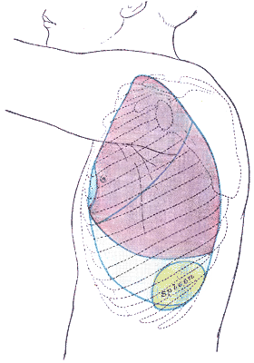
Splenic trauma
Upper abdomenal organs may be damaged by
direct blow to the epigastrium with deformation of the abdominal wall,
  Eg punch or kick
avulsion of the blood supply by rapid deceleration,
  Eg a fall from height , thrown
puncture by a fractured rib,
crushing against the vertebral column.

Slide 15
Duodenal haematoma
Duodenal haematoma from blow to abdomen (Medscape)
May cause bowel obstruction

Slide 16
Pancreatic trauma
Pseudocyst
Epigastric abdo pain + raised enzymes
Pancreatitis in children 23% caused by trauma
(25% unknown cause)

Slide 17
Renal contusion and subcapsular haemorrhage
URINALYSIS
So easy to do
So often forgotten!

Slide 18
Intra-abdo trauma tests
FAST
  -ve result reassuring
Abdo CT
Abdo x-ray (E&S)
MRI (“whole body” infants)
Lavage / laparoscopy
FBE (Serial Hb, retics)
Clotting
LFT (might repeat)
U&E
Lipase, amylase
URINALYSIS

Slide 19
Spinal /vertebral trauma
Image cervical spine in infants when AHT is considered
Subdural blood may track down from SDH in posterior fossa
Hyperflexion/hyperextension forces can occur during shaking
Hyperflexion can occur when thrown, punched or kicked
Compression vertebral body fractures may occur when infant “slammed” onto firm surface

Slide 20
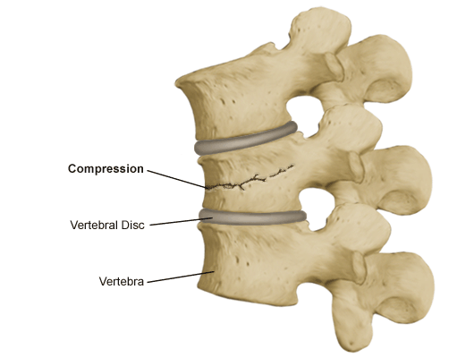
Compression fracture vertebrae
Slamming (axial loading forces) or hyperflexion

Slide 21
Strangulation
In adults/adolescents – seen in context of sexual assault and intimate partner violence
In children – probably under-recognised
Beware if story of LOC or memory gaps after assault
Might need 24 close observation because neck structures swell and airways can be suddenly compromised!
Treat any symptoms and signs of neck trauma VERY seriously

Slide 22
NB: Absence of neck skin injury does NOT exclude damage to underlying neck structures
Excellent resources at
www.strangulationtraininginstitute.com
Note relative lack of information about children
Food for thought
Should we be equally concerned about children who have symptoms and signs as a result of “choker holds” and/or compression of neck from clothing and jewellery?

