Slide 1

Course Applications, Scholarships, and the Special Entry Access Scheme (SEAS)
VICTORIAN TERTIARY ADMISSIONS CENTRE
40 Park Street, South Melbourne, VIC 3205
Telephone: 1300 364 133
www.vtac.edu.au
Thursday 9 June 2015
Twitter: twitter.com/vtacguide | Blog: blog.vtac.edu.au | Facebook: www.facebook.com/vtacguide | Youtube: www.youtube.com/user/vtacmedia

Slide 2
VTAC Applications
Course applications: VTAC is the central point for applications to study tertiary courses (VET and Higher Education) in Victoria
SEAS applications: The Special Entry Access Scheme is a special consideration program that allows selection officers to consider educational disadvantage when making offers
Scholarship applications: VTAC collects Scholarship applications on behalf of many Victorian institutions, including scholarships related to equity/disadvantage.
All applications are completed online through the same user account at:
www.vtac.edu.au

Slide 3
Key dates
Key dates for 2015-2016 applications
Applications open | 9am, Monday 3 August 2015
Timely applications close | 5pm, Wednesday 30 September 2015
SEAS applications close | 5pm, Tuesday 6 October 2015
Scholarship applications close | 5pm, Friday 16 October 2015
Round 1 offers released | Monday 18 January 2016
Full list of dates: http://www.vtac.edu.au/dates.html

Slide 4
Connect with VTAC now
Prepare now by connecting with VTAC on:
  Facebook: facebook.com/vtacguide
  Twitter: @vtacguide
  Blog: blog.vtac.edu.au (subscribe by email)
We post timely information, application tips, course updates, and reminders before important closing dates
Notes:
Guest post in previous years: institution on how to write SEAS statement

Slide 5
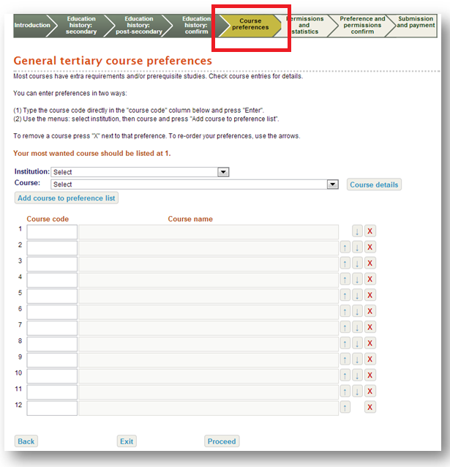
Course Application
Information about courses:
  Printed and eBook VTAC Guide 2016
  CourseSearch at www.vtac.edu.au
Register for a VTAC user account and apply online
List up to 12 courses in the order you want to take them
You can change your preferences before and after each round (check closing and opening dates online)
Notes:
Check selection criteria etc.

Slide 6
Special Entry Access Scheme (SEAS)
Types of special consideration:
  SEAS through VTAC
  Other special consideration and bonus schemes not part of SEAS (list on the VTAC website)
SEAS is the umbrella program in which most VTAC institutions participate and is for applicants who have experienced educational disadvantage.
  One SEAS application through VTAC for all your preferences
  Some institutions refer to SEAS by other names, e.g. Access Melbourne
SEAS allows selection officers at institutions to grant special consideration for course entry to applicants, but does not exempt applicants from meeting course requirements.
  You must meet course prerequisites, attend all interviews, sit any required tests, and submit all required folios and forms.

Slide 7
Applying for SEAS
SEAS application becomes available in the user account after a course application has been submitted.
All categories are on the same page
Submit early
  SEAS applications open at the same time as course applications
  You can update your SEAS application as often as you like before the closing date
Applications and supporting documentation must be received no later than the closing date (5pm, Tuesday 6 October 2015)
  Gather supporting evidence early
  Allow time for postage
Notes:
Apply for as many categories as are relevant

Slide 8
SEAS Categories
Category 1: Personal information and location
    As simple as ticking a box
    All applicants should apply for this category
Category 2: Difficult circumstances
    E.g. disruption to living situation, affected by death of relative/friend, natural disaster, refugee status
Category 3: Disadvantaged financial background
Category 4: Disability or medical condition
Category 5: Institution-specific schemes
    Usually related to under-represented schools; see institution websites for details

Slide 9
SEAS documentation
Category 1 (Personal Information and Location):
  no documentation needed, just consent to use application information
Category 2 and 4 (Difficult Circumstances; Disability or Medical Condition):
  Impact Statement and Statement of Support
Category 3 (Disadvantaged Financial Background):
  Centrelink number of applicant
  OR hard copy of family member’s Centrelink documents
  OR Impact Statement and Statement of Support
Notes:
Do not provide CRN of family member for Cat 3

Slide 10
SEAS documentation
Where needed:
Impact statement – written by applicant
Statement of support – written by relevant responsible person
Impact statements without an accompanying
statement of support will not be considered.

Slide 11
SEAS impact statements
Impact statements should include how circumstances have adversely affected:
  Ability to study and perform assessment tasks
  Access to educational resources
  Attendance in school/tuition
Good impact statements are:
  Personal and sincere
  Succinct
  Explain the context, date and impact of the disadvantage on studies
Impact statements are completed online by the applicant.

Slide 12
SEAS statements of support
Applicants should ask those providing a statement of support to:
  Clearly outline the situation, or if Category 4 (disability or medical) condition
  Include a timeline, such as how long they have known (or been treating) the applicant
  Outline how the applicant has been impacted
Encourage students to make medical appointments now. Statements of support can be collected now, and submitted once applications open.
Evidence and impact is the key.
Statements of support can be submitted online or in hard copy.

Slide 13
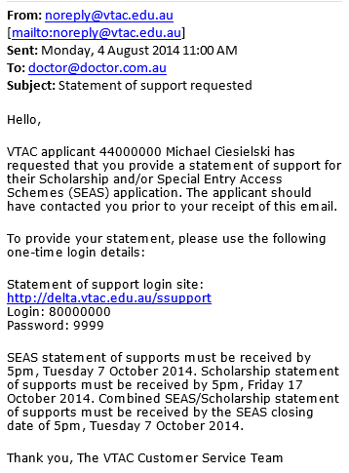
Online statements of support
Process:
  You enter the provider’s name and email address
  Provider receives an email with link, login name, and password
  Provider completes statement
  Applicant can log in to user account and verify that one-time provider login details have been used
Online statements of support can be used for both SEAS and scholarships (if the applicant selects that option).

Slide 14
Hard copy SEAS documentation
Download personalised cover sheet from VTAC user account, and send with documentation by post
Make sure correct cover sheet is used
  SEAS documentation cannot be used for Scholarships and vice versa due to privacy regulations
    Exception: Combined online statements of support

Slide 15
Confirming submission of SEAS application
SEAS application receipt by email and in VTAC user account
Date of last documentation upload visible in VTAC user account
You are not advised of specific outcomes or ATAR/aggregate bonus
  Institutions make their own assessments of SEAS applications
  Some institutions publish information or policies about this

Slide 16
Scholarships
VTAC collects scholarship applications for many institutions
  One application, many institutions
Scholarships are not just for academic performance
Many equity scholarships have similar documentation requirements to SEAS
  Statements must be submitted separately for each using the correct coversheet.
List of scholarships available on the VTAC website
  Including scholarships which require direct applications to institutions

Slide 17
Remember
More information and getting help
Facebook: facebook.com/vtacguide (send us a PM)
Twitter: @vtacguide (send us a DM)
Blog: blog.vtac.edu.au
Phone: 1300 364 133
Web: www.vtac.edu.au
Email through the VTAC website
The SEAS application only becomes available after submitting a course application
Apply early – you can update your application as many times as you like before the closing date
Check documentation requirements carefully

