Slide 1
Applying for tertiary study, scholarships, and special consideration
VICTORIAN TERTIARY ADMISSIONS CENTRE
40 Park Street, South Melbourne, VIC 3205
Telephone: 1300 364 133
www.vtac.edu.au
Tuesday 25 July 2017
Twitter: twitter.com/vtacguide| Facebook: www.facebook.com/vtacguide | Youtube: www.youtube.com/user/vtacmedia

Slide 2
VTAC Applications
Course applications: VTAC is the central point for applications to study tertiary courses (VET and Higher Education) in Victoria
SEAS applications: The Special Entry Access Scheme is a special consideration program that allows selection officers to consider educational disadvantage when making offers
Scholarship applications: VTAC collects Scholarship applications on behalf of many Victorian institutions, including scholarships related to equity/disadvantage.
All applications are completed online through the same VTAC account at:
www.vtac.edu.au

Slide 3
Key dates
Key dates for 2017-2018 applications
Applications open | Monday 7 August 2017
Timely applications close | 5pm, Thursday 28 September 2017
SEAS applications close | 5pm, Tuesday 10 October 2017
Scholarship applications close | 5pm, Friday 13 October 2017
Round 1 offers released | Tuesday 16 January 2018
Full list of dates: http://www.vtac.edu.au/dates.html

Slide 4
Connect with VTAC now
Prepare now by connecting with VTAC on:
Facebook: facebook.com/vtacguide
Twitter: @vtacguide
We post timely information, application tips, course updates, and reminders before important closing dates

Slide 5
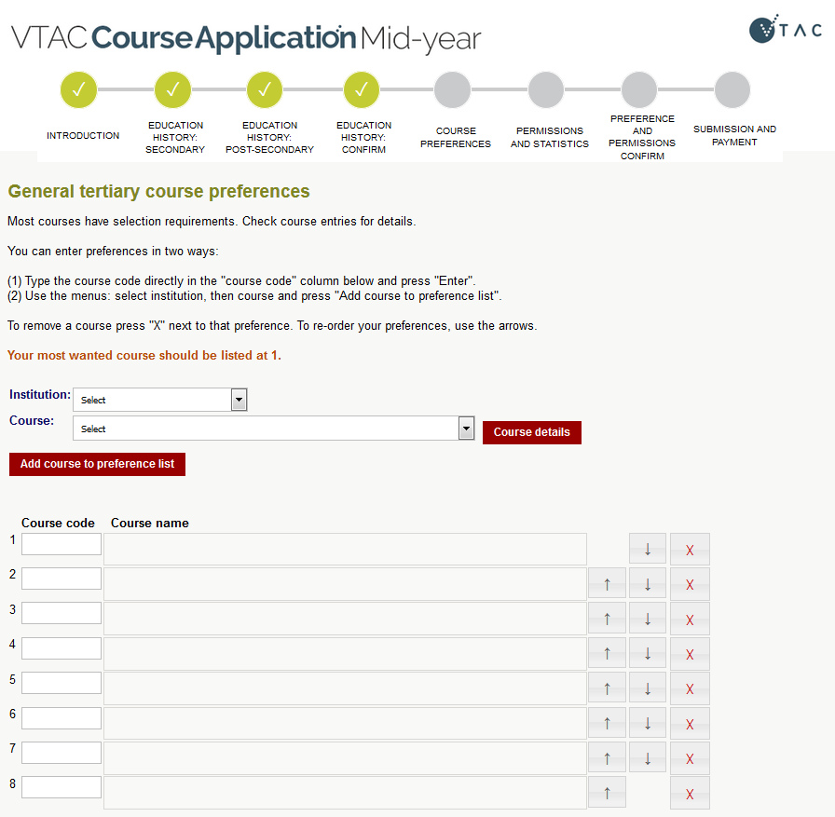
Course Application
Information about courses:
CourseSearch at www.vtac.edu.au
The VTAC CourseSearch App (free)
Register for a VTAC account and apply online
List up to 8 courses in the order you want to take them
You can change your preferences before and after each round (check closing and opening dates online)

Slide 6
Selection data – how competitive is this course?
Applicants for an example course selecting on ATAR with 4 places and 6 applicants:
 | ATAR | Offered a place?
Mel | 95.00 ATAR | Yes
Geri | 90.00 ATAR + subject bonus = 95.00 rank | Yes
Victoria | 85.00 ATAR | Yes
Emma | 80.00 ATAR | No
AJ | 75.00 ATAR + SEAS + subject bonus = 86.00 rank | Yes
Howie | 70.00 ATAR | No
Clearly-in is 85.00: everyone at this ATAR or above received an offer
% below: One out of four offers was made to an applicant with an ATAR below 85.00, so the % below is 25%

Slide 7
Special Entry Access Scheme (SEAS)
Types of special consideration:
SEAS through VTAC
Other special consideration and bonus schemes not part of SEAS (list on the VTAC website)
SEAS is the umbrella program in which most VTAC institutions participate and is for applicants who have experienced educational disadvantage.
One SEAS application through VTAC for all your preferences
Some institutions refer to SEAS by other names, e.g. Access Melbourne

Slide 8
What can SEAS do?
 | ATAR | Offered a place?
Mel | 95.00 ATAR | Yes
Geri | 90.00 ATAR + subject bonus = 95.00 rank | Yes
Victoria | 85.00 ATAR | Yes
Emma | 80.00 ATAR | No
AJ | 75.00 ATAR + SEAS + subject bonus = 86.00 rank | Yes
Howie | 70.00 ATAR | No
SEAS does not exempt you from meeting course requirements.
You must study course prerequisites, attend all interviews, sit any required tests, and submit all required folios and forms.
SEAS is not a guaranteed entry scheme or reserved quota, but may allow you to gain entry to a course with a lower ATAR than otherwise

Slide 9
Applying for SEAS
SEAS application becomes available in the VTAC account after a course application has been submitted.
All categories are on the same page
Submit early
SEAS applications open at the same time as course applications
You can update your SEAS application as often as you like before the closing date
Applications and supporting documentation must be received no later than the closing date (5pm, Tuesday 10 October 2017)
Gather supporting evidence early
Allow time for postage if submitting in hard copy

Slide 10
SEAS Categories
Category 1: Personal information and location
As simple as ticking a box
All applicants should apply for this category
Category 2: Disadvantaged financial background
Category 3: Disability or medical condition
Category 4: Difficult circumstances
E.g. disruption to living situation, affected by death of relative/friend, natural disaster, refugee status

Slide 11
SEAS documentation
Category 1 (Personal Information and Location):
no documentation needed, just consent to use application information
Category 2 (Disadvantaged Financial Background):
Centrelink number of applicant
OR hard copy of family member’s Centrelink documents
OR Impact Statement and Statement of Support
Category 3 and 4 (Disability or Medical Condition; Difficult Circumstances):
Impact Statement and Statement of Support

Slide 12
SEAS documentation
Where needed:
Impact statement – written by applicant
Statement of support – written by relevant responsible person
Must be a healthcare professional for Category 3
Impact statements without an accompanying statement of support will not be considered.

Slide 13
SEAS impact statements
Impact statements should include how circumstances have adversely affected:
Ability to study and perform assessment tasks
Access to educational resources
Attendance in school/tuition
Good impact statements are:
Personal and sincere
Succinct
Explain the context, date and impact of the disadvantage on studies
Impact statements are completed online by the applicant.

Slide 14
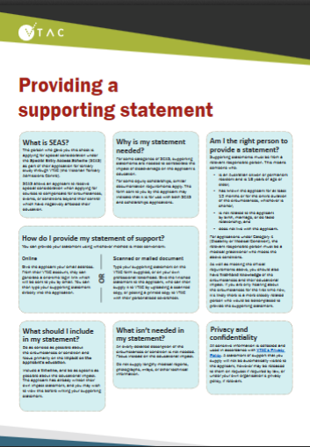
What to include in supporting statements
Focus on the educational impact
Both impact and supporting statements are in two sections:
Description of circumstances (500 characters)
Educational impact (1500 characters)
Download our one-page fact sheet which can be provided to e.g. doctors for some background information about SEAS and what to include
Make medical appointments now. Statements of support can be collected now, and submitted once applications open.

Slide 15
Three options for providing documentation
Uploading
Via the VTAC account
Hard copy
Mailed to VTAC with the relevant cover sheet
Uploads are checked for legibility and the applicant notified if documents not accepted
Must be received by the closing date
Online statements of support
Login generated through VTAC account and sent directly by email to provider
Check user account for status

Slide 16
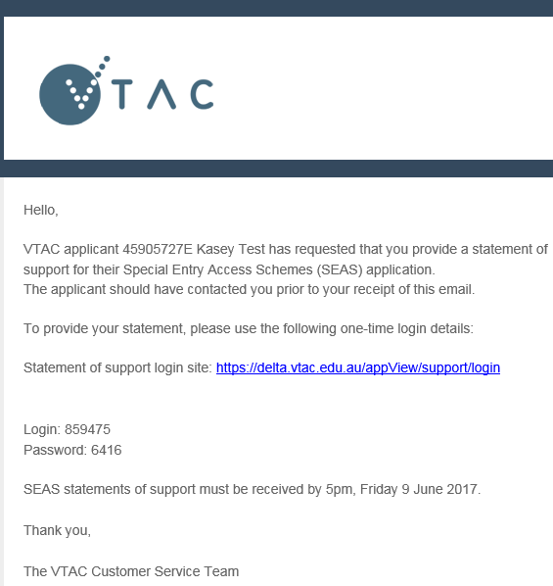
Online statements of support
Process:
You enter the provider’s name and email address
Provider receives an email with link, login name, and password
Provider completes statement
You can log in to user account and verify that one-time provider login details have been used
Online statements of support can be used for both SEAS and scholarships (if the applicant selects that option).

Slide 17
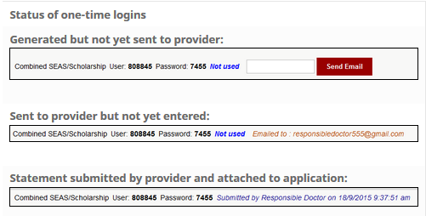
Checking whether a statement of support has been submitted

Slide 18
Hard copy or scanned SEAS documentation
Hard copy
Download personalised cover sheet from VTAC account, and send with documentation by post
Make sure correct cover sheet is used
SEAS documentation cannot be used for Scholarships and vice versa due to privacy regulations
Exception: Combined online statements of support
Scanned
Upload from the SEAS tab of the VTAC account online

Slide 19
Confirming submission of SEAS application
SEAS application receipt by email and in VTAC account
Date of last documentation upload visible in VTAC account
You are not advised of specific outcomes or ATAR/aggregate bonus
Institutions make their own assessments of SEAS applications
Some institutions publish information or policies about this

Slide 20
Scholarships
VTAC collects scholarship applications for many institutions
One application, many institutions
Scholarships are not just for academic performance
Many equity scholarships have similar documentation requirements to SEAS
Statements must be submitted separately for each using the correct coversheet or uploaded to the correct section of the VTAC account.
List of scholarships available on the VTAC website
Including scholarships which require direct applications to institutions

Slide 21
Remember
More information and getting help
Facebook: /vtacguide (send us a message)
Twitter: @vtacguide (send us a DM)
Phone: 03 9926 1020
Web: www.vtac.edu.au
Email through the VTAC website
The SEAS application only becomes available after submitting a course application
Apply early – you can update your application as many times as you like before the closing date
Check documentation requirements carefully

