Slide 1
Studying at The DECV
Laura King
Youth Forum 2017

Slide 2
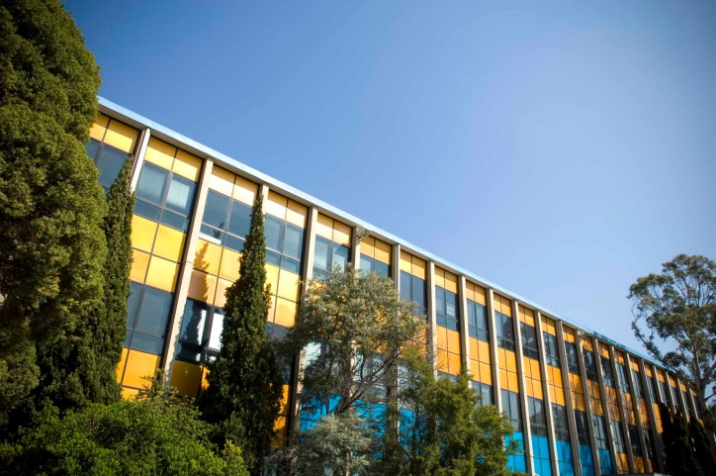
Today’s presentation
Brief overview of DECV
How does DECV work?
Flexibility of enrolment
Supports available to students
A snapshot of DECV online

Slide 3
DECV is Victoria’s leading virtual school
Flexible learning
135 subjects
4,500 students
Notes:
We provide flexible learning opportunities to a diverse and unique cohort of Victorian Foundation-Year 12 students
Students can study approximately 135 subjects, including VCE subjects
Our 4,500 students from Foundation through to Year 12 make us the largest school in Victoria

Slide 4
Children and young people choose to study at DECV for a variety of reasons
Mainstream school-based students seeking access to the subjects they need
Students with medical, physical or social and emotional needs
Elite young sportspeople and performers
Students unable to attend school due to travelling
Young adults wishing to study in a way they find engaging
Plus more…
Notes:
Mainstream school-based students who don’t have access to the subjects they need in their own school
Students with medical, physical or social and emotional needs that make it difficult for them to attend mainstream schooling
This year we have catered for around 1000 students under that category
Elite young sportspeople and performers
Children and young people unable to attend school due to travelling
Young adults wishing to complete their education in a way that they find engaging
Plus more…

Slide 5
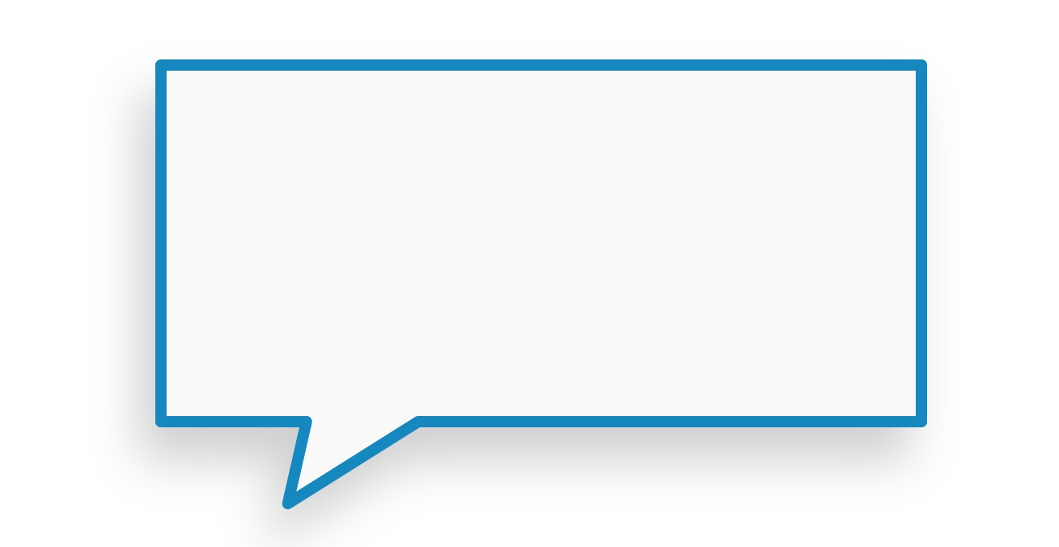
Our broad student cohort means we must be flexible and understanding of students’ needs
Notes:
Every member of our staff is dedicated to building the confidence and resilience of each DECV student
Teachers provide individualised learning and support to students on a daily basis
We take a great deal of pride in helping students to prepare for university, higher learning or employment beyond their time at DECV

Slide 6
Virtual education’s flexibility helps students achieve their goals
Notes:
Students can re-visit classes and generally choose when they wish to study i.e. morning or afternoon
Our virtual classroom provides the opportunity to interact with fellow students and teachers on a daily basis
The classroom contains a broad range of teaching a learning materials
Students can submit and receive their work via this classroom
Special provisions are available to students when they provided the relevant documentation including modification, extensions and special exam arrangements.
The minimum requirement for the award of VCE across years 11 & 12 is the satisfactory completion of 16 units. A standard program usually includes 4 year 11 subjects and 4 year 12.
Must also include:
three units from the English group, with at least two consecutive units at Unit 3 and 4 level
at least three subjects other than English at Units 3 and 4 level, which may include any number of English sequences once the English requirement has been met.
If you are 18 on the 1st of January on the year of enrolling make sure to enquire about enrolling under an adult VCE, as the guidelines are different
VCE does not need to be completed in 2 years! Many of our students are spreading their subjects across 3 or 4 years. Students may chose to do a scored VCE which will allow you to get an ATAR score for university or a Non-Scored VCE which will provided them with their VCE certificate.

Slide 7
The Student Experience at DECV
How do students enrol?
How does the DECV work?

Slide 8
How do students enrol?
School-based students
Maximum of two subjects in Year 11 & 12
Maximum of one subject in Years 7-10
Approval needed from Principal
DECV-based students
Students must meet eligibility criteria in order to enrol http://www.distance.vic.edu.au/direct-enrolments/
In medical cases, referral required from previous school and treating medical specialist
Shared enrolment between DECV and another school is possible
Notes:
Year’s 11-12 2017 enrolments are now closed.
Enrolments for 2018 open on Monday 16th October 2017.
For students enrolling in Years F-10, 2017 enrolments are open until 4 August 2017.

Slide 9
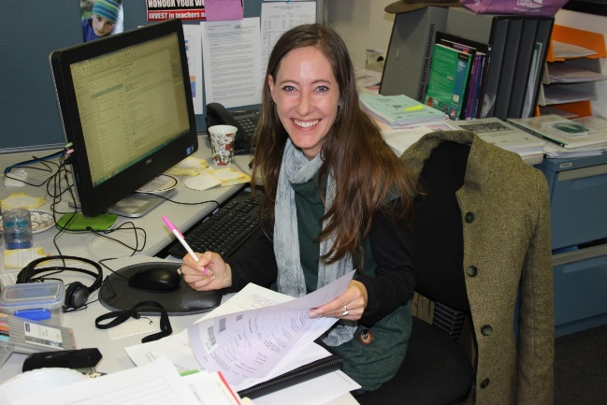
How does the DECV work?
Flexible learning approach
Structured learning materials available online
Personalised teaching and feedback by specialist subject teachers
Opportunities for collaboration with other students
Online classes
Face-to-face seminars/ excursions
Online collaborative tasks

Slide 10
What do I need to study at the DECV?
A quiet place to work
Access to a device with internet
To access your emails/ online regularly.
Access to a webcam, microphone and video-conferencing equipment, if required.
Keep DECV teacher up to date regarding any situations that might impact upon a student’s ability to engage with their studies

Slide 11
How does assessment work?
Assessments in Year 12 are posted to the student’s nominated supervisor at least two weeks prior to the set date. Assessments have different time allocations and conditions. Supervisors will be informed of this.
Students can complete assessments anytime in the designated week, at a time agreed with their supervisor
Year 12 exams can be sat the DECV or nominated exam centre.
Notes:
Year 11 may be posted or available online.
If completing a science based subject you may be asked to come into the Lab to complete pracs this could be around once or twice a semester.
DECV is a registered government school and curriculum is based on VCAA’s study design to award student with their VCE.

Slide 12
Notes:
+ More

Slide 13
A snapshot of DECV online
https://lms.decvonline.vic.edu.au/login/index.php
Notes:
Show student example

Slide 14
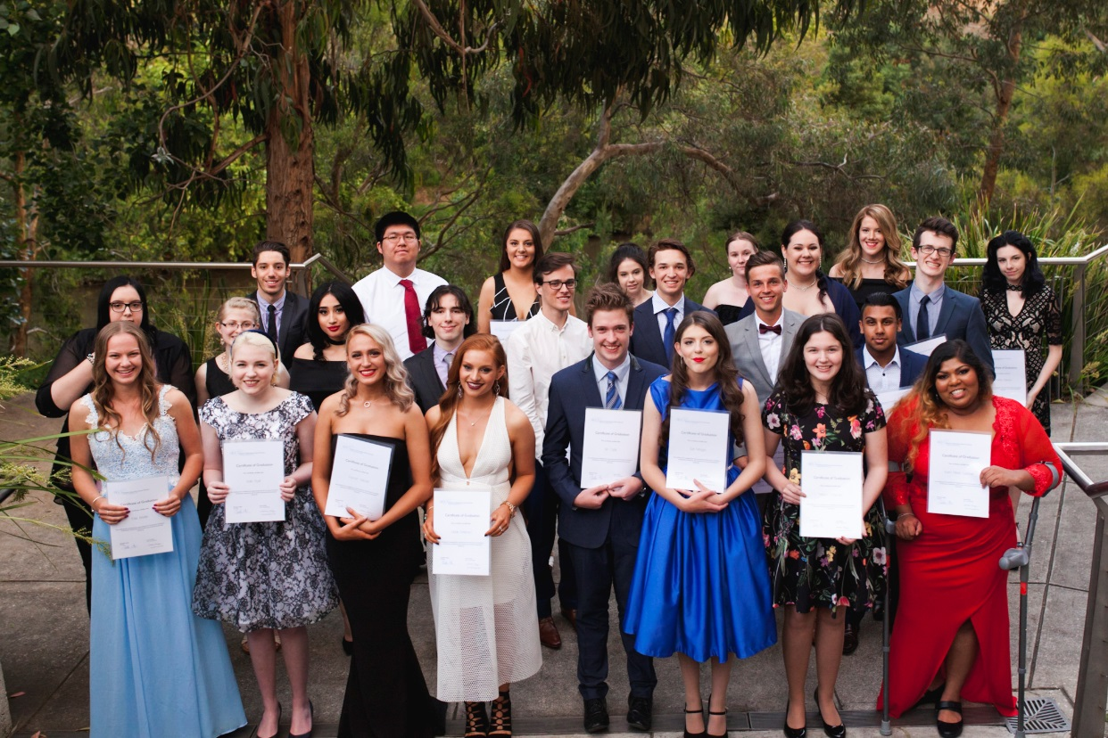
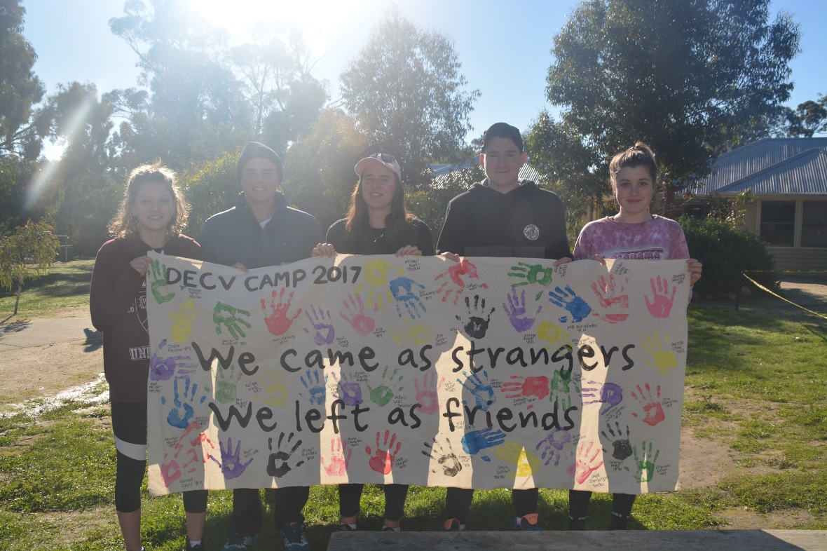
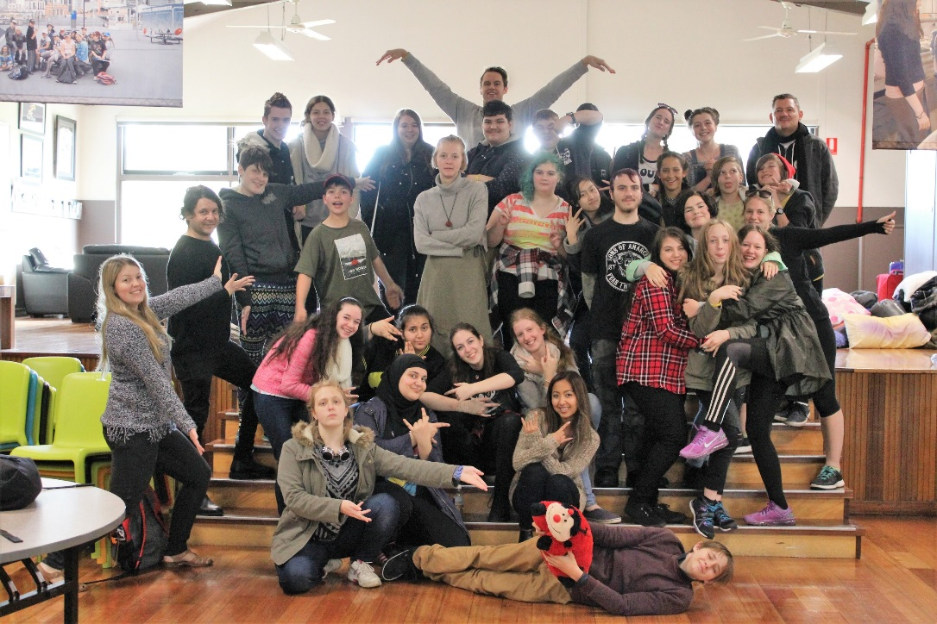

Slide 15
The Student Experience at DECV
Any Questions?

Slide 16
Questions about enrolment and our subjects?
Phone: (03) 8480 000
Free Call: 1800 133 511
Email:enrol@distance.vic.edu.au

