Slide 1
Readiness to proceed to transplantation
Consultant interview
May 2017

Slide 2
Checklist
Are all work up requirements complete?
  Tissue typing x2
  Viral serology
  Dental assessment
  Immunisations
  Cardiology assessment
  Urology assessment
  Transplant surgeon assessment
  Other specialties
Have you read information provided about kidney transplantation?
    Kidney transplantation (RRC booklet)
    KHA kidney transplantation sheet
    Medication summary

Slide 3
Types of kidney transplants
Live donor
  Usually family member
  Close relationship
Australian Paired Kidney Exchange program
  National
  RCH has participated in 6 chains
    ABO incompatible
    DSA
    Hep B pos donor
Deceased donor
  Patient must be on dialysis
  Criteria set around donor upper age limits
  Extended criteria
  Paediatric priority
    when a patient has been on dialysis for >12 months (100000 bonus points)

Slide 4
Patient survival
Potential for donor or recipient death
Very uncommon

Slide 5
Transplant survival
Main causes of kidney transplant (graft) loss
  Technical reasons
  Donor age
  Acute rejection
  Chronic rejection
  Recurrent disease
  Non compliance (ie not taking required medications)
  Chronic Allograft Nephropathy (CAN)

Slide 6
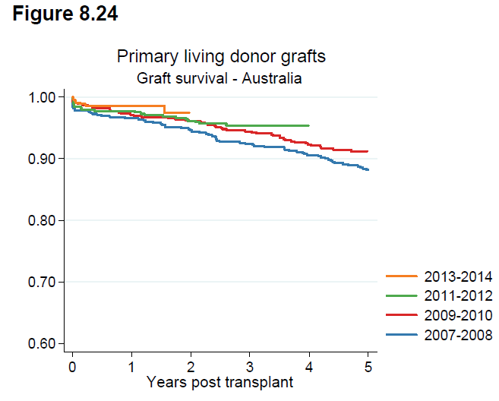
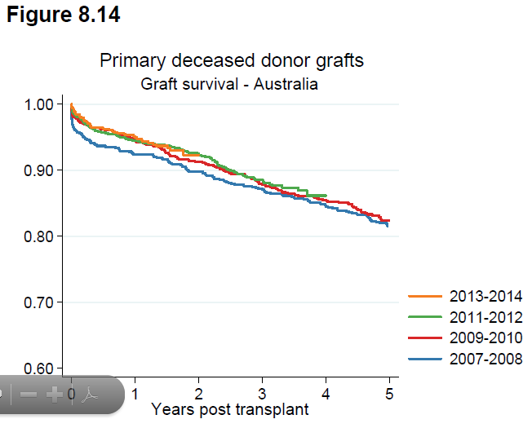
Transplant survival

Slide 7
Admission for transplant surgery
Live donor transplant
Preadmission
  10 days prior
  Day visit only
Admission
  Tacrolimus and Mycophenolate will start 3 days prior to admission
  Patient admitted to Koala ward the afternoon before operation.
  IV to be inserted
  Blood, urine and fluid tests.
  Weight
  IV fluids
  Fasting
  +/- PD overnight (empty pre surgery)
Deceased donor recipient
Preadmission
  Nil
Admission
  Consultant - call to family for phone review of patient
  Patient ⇒ RCH
  Fasting as directed
  Admission to Koala ward via emergency or directly to Koala ward
  Nursing admission
  Weight
  IV to be inserted, Blood, urine and fluid tests then commence IV fluids
  PD or HD if required (directed by consultant)

Slide 8
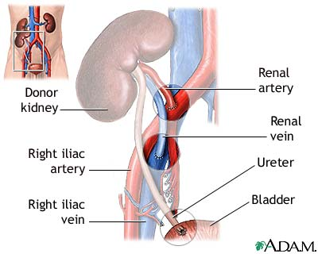
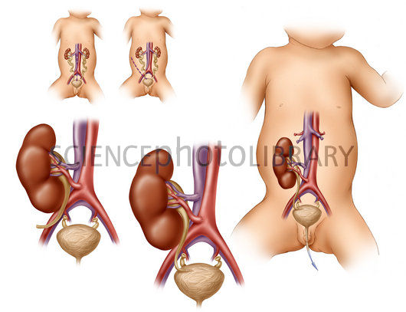
Position of transplant

Slide 9
Post surgery risks / possible interventions
Risk
  Fluid overload
  Hypertension
  Renal vein thrombosis
  Post-op bleeding
  Primary non function
  Bacterial infection
Potential interventions
  Admission to PICU
  Return to theatre
  Scans (ie ultrasound, Mag3
  Transplant biopsy

Slide 10
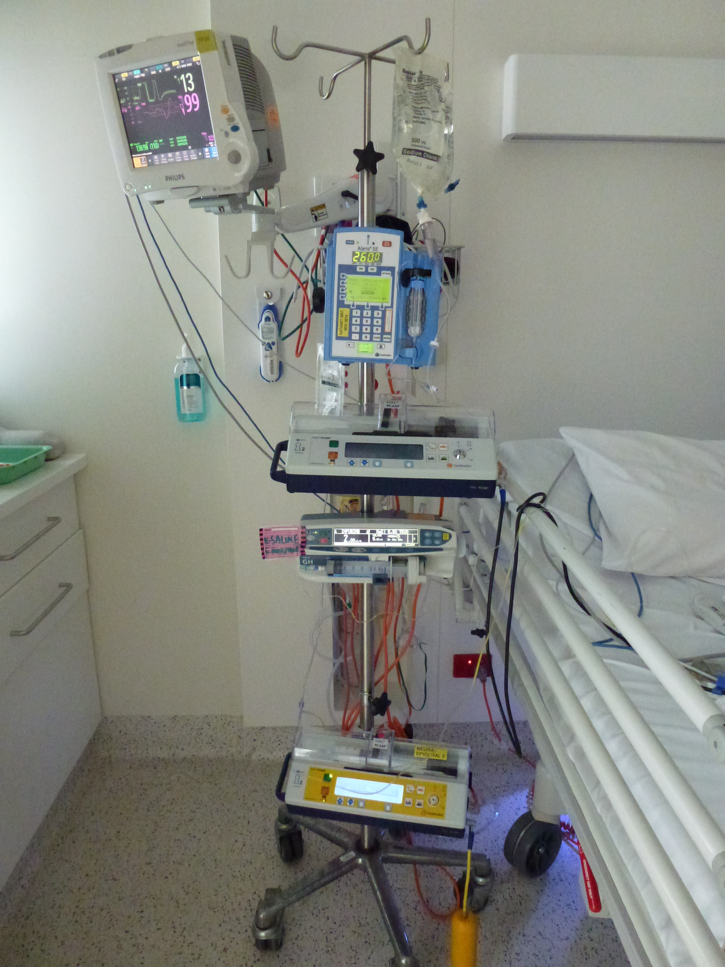
Post op care
Observations
Fluid balance
Infusions
Medications
Blood & urine sampling
Drains and lines
Pain management
Physiotherapy
Dietician

Slide 11
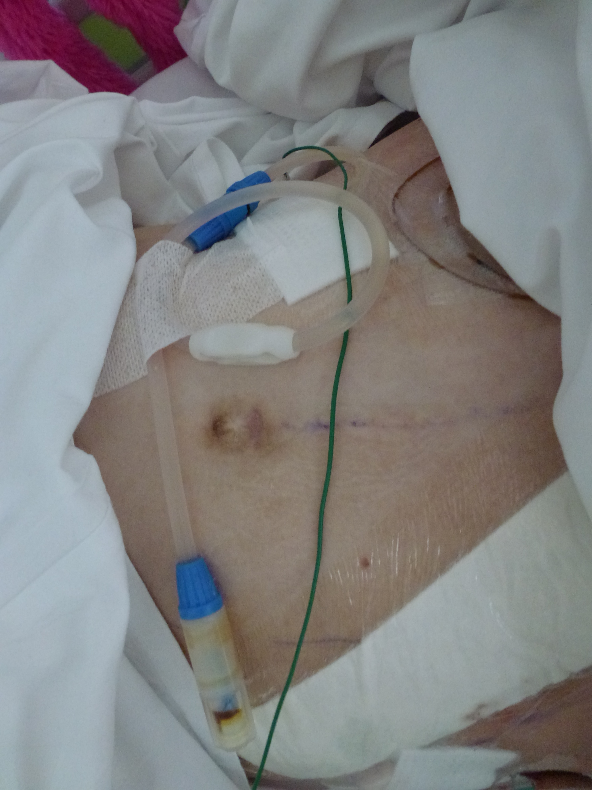
Lines and access
Arterial lines – patient may or may not arrive in recovery with an art line, will be removed if transferring to Koala ward
+/- Tenckhoff catheter (PD). Ensure adequate dressing insitu.
+/- Permacath (HD)
CVC
Peripheral IV’s (at least 1)
IDC
Redivac
+/- wound dressing (preference for glue only)
Wound catheter or epidural

Slide 12
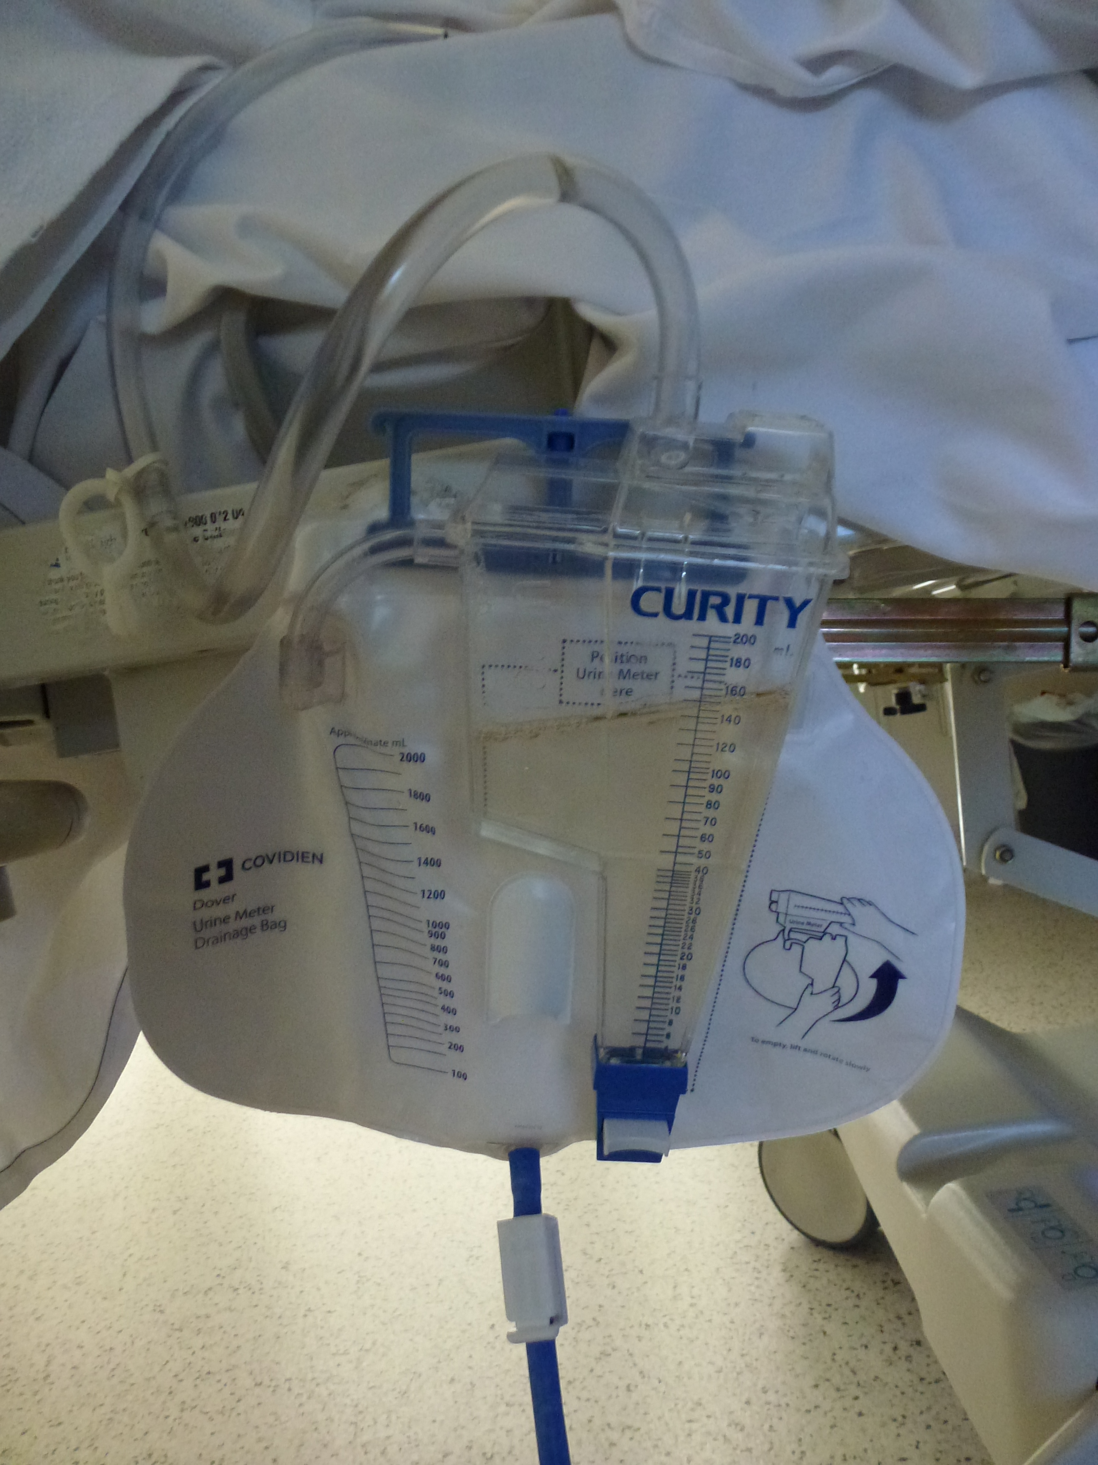
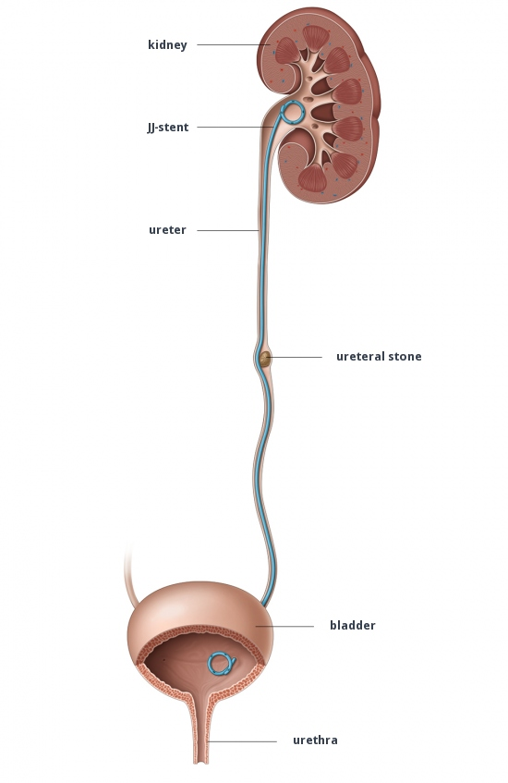
Urine drainage

Slide 13
Medications
Anti rejection
  Basiliximab
  Prednisolone
  Tacrolimus
  Mycophenolate
  Sirolimus, azathioprine, cyclosporine, ATG

Slide 14
Medications
Electrolyte loss
  Bicarbonate
  Phosphate
  Magnesium
  Calcium
Gastritis
  Ranitidine
  Omeprazole
High blood pressure
  Ramipril
  Atenolol
  Amlodipine
  Etc.
Infection preventers
  Bacterial
  Viral

Slide 15
Medications
Anti rejection medications must be taken as directed
Non compliance will lead to rejection
Patient should always have extra supply available
Some medication doses are adjusted according to blood levels.

Slide 16
Medium to long term considerations
Weight gain – can be significant post transplant
Fitness/exercise – vascular/cardiac health
Rejection – acute or chronic
Infections – bacterial or viral
High blood pressure - may require medication
Malignancy – skin protection, screening
Education – Coping strategies etc.
Travel – preparation (ie insurance, travel letters, emergency plan)
Pregnancy – impact on patient and foetus
Transition – developing independence

Slide 17
Clinic reviews post discharge
1st month – daily
2nd month – 3 x week
3rd month – 2 x week
4th month – weekly
5th month – 2nd weekly
6 ⁻12 months – monthly
12 months onwards consider 6 weekly if stable
This plan will be individualised according to patient stability.
At clinic visit
  Weight, BP, medical review, blood test, urine test.

Slide 18
Other considerations
Annual review (will vary depending on age)
  Donor Specific Antibodies
  Fasting blood test
  Skin check
  Dental review
  +/- bone density
  +/- cardiology
  Education supports
  Transition

