Slide 1
The Royal Children’s Hospital, Melbourne
CBC Conference 2021 e- Ethics Series
The ethics of deferring surgery in children with intersex variations

Slide 2




This module is based on a talk presented at the National Paediatric Bioethics Conference, 2021
How long should we wait to hear the child’s view? The ethics of deferring surgery and other interventions in children with
intersex variations
Prof Sonia Grover;
Director of Gynaecology,
Royal Children’s Hospital,
Melbourne
Mr Juan Bortagaray;
Paediatric Urologist,
Royal Children’s Hospital, Melbourne
Dr Michele O’Connell;
Paediatric Endocrinologist, Dept of
Endocrinology and Diabetes, RCH Gender
Service
Ms Chloe Hanna;
DSD Clinical Coordinator,
Royal Children’s Hospital

Slide 3

Aims of this module
To understand what ‘intersex variations’ and ‘differences of sex development’ are and how they present clinically.
To consider some of the ethical complexities associated with these variations including;
- Changing medical practices and social attitudes
- Australian regulation of the treatment of intersex variations in paediatric healthcare nationally and state- by- state
        - The ethical rationale underpinning these policies
        - The ethical issues in deferring surgical and other interventions

Slide 4




How to use this module
This module should take 30 minutes to complete.
Use the <PREV NEXT> buttons on the bottom right to move forward and back.
There are some clips from the presentation, some ethical discussion and some resources for more information or further reading.
Resources and further reading are hyperlinked throughout the module and are also accessible via clicking the ‘Resource’ tab on the top navigation bar.
The icons below are used throughout this module to indicate:
  Module instructions, directions and teaching
  slides
  Definitions, quotes and statistics from
  literature
  Video clips from the conference presentation
  Additional references

Slide 5
Intersex variations
‘Intersex’ is an umbrella term for people born with atypical sex characteristics. (OII Australia, 2012b)
Sex characteristics include:
Chromosomes
Genes
External genitalia
Internal reproductive organs
Hormones
Secondary characteristics (i.e. body hair)
“[A] variety of conditions that can present at birth or later in life whereby an individual’s chromosomes, hormones or sexual organs differ from the ’norm’ in a way that does not correspond to ‘typical definitions of male and female.”
Jenkins, T. M., & Short, S. E. (2017)

Slide 6
The following case example introduces a child with an intersex condition called 5-Alpha Reductase Deficiency.
It illustrates some of the complexities and tough ethical questions faced by clinicians and families.

Slide 7
5-Alpha Reductase Deficiency- A definition
5-alpha reductase deficiency is an inherited condition that primarily affects male sexual development before birth and during puberty. People with this condition are genetically male, with one X and one Y chromosome in each cell, and they have male gonads (testes).
Their bodies, however, do not produce enough of a hormone called dihydrotestosterone (DHT), which is critical for male sexual development. Most are born with external genitalia that appear female.
In other cases, affected individuals may have ambiguous genitalia. Others may have genitalia that appear predominantly male, often with an unusually small penis (micropenis) and the urethra opening on the underside of the penis (hypospadias).
Genetics Home Reference. April 2008.
The following video explores a case study of an infant born with 5-Alpha Reductase Deficiency…

Slide 8

Ms Chloe Hanna, DSD Clinical Coordinator, Royal Children’s Hospital, Melbourne (2.21mins) **Click on ‘play’ button below video

Slide 9
We will return to this family and the questions raised by a 5-Alpha Reductase Deficiency diagnosis soon.
But first, let’s take a step back and think about how to understand DSDs in general, and what social and ethical complexities can emerge in the clinical management of children with these differences.
The next video clip explores how intersex variations occur, how common they are, and how they have traditionally been treated…

Slide 10
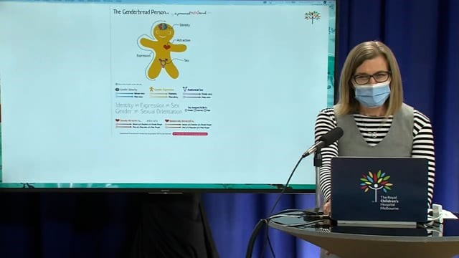
Dr Michele O’Connell, Paediatric Endocrinologist,
Dept of Endocrinology and Diabetes, RCH Gender Service. (3.06mins)
Notes:
Video Clip 2: NOTE THE ‘PLAY’ BUTTON IN THE CENTRE OF CLIP, AND ABILITY TO SEE THE TIMELINE ALONG THE BOTTOM DURING THE CLIP PLAYING.

Slide 11
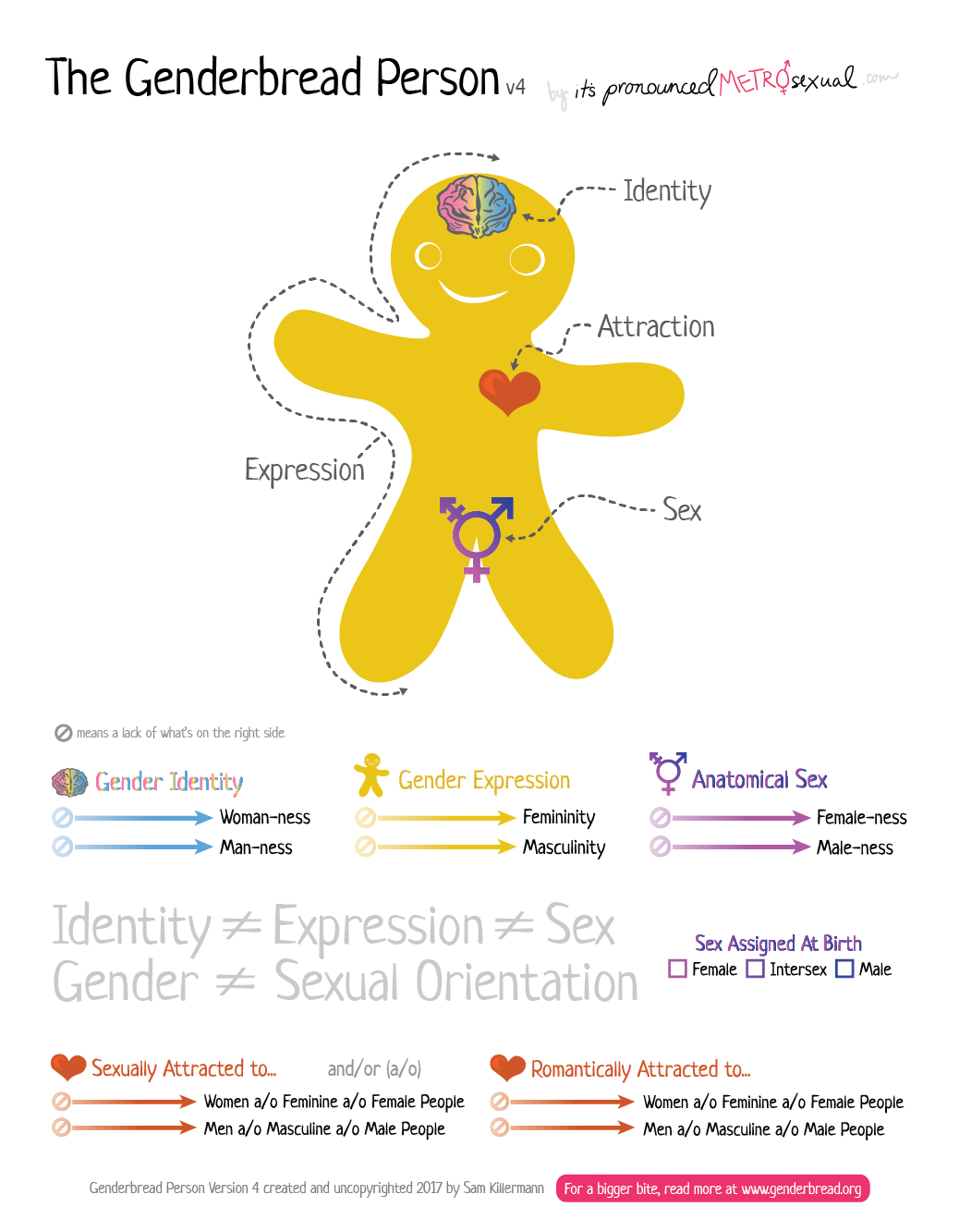
Genderbread Person
Sex/gender distinction:
Sex- Biological difference or spectrum between male and female.
Gender- Primarily about how people identify, and think of themselves. This is independent of their physical characteristics.
Learn more about the ‘Genderbread Person’ referred to by Dr O’Connell in the earlier video clip. https://www.genderbread.org/

Slide 12
Debate over language used
As Dr O’Connell mentioned in the clip, there is ongoing debate in the discourse about how to describe children born with ambiguous or atypical genitalia;
  The term ‘differences of sex development’ (or DSD) is widely used in the clinical domain as an umbrella term to describe children born with the appearance of external genitalia that is at variance with typical development for either sex.
  However, this language is increasingly viewed by affected patients and families as out of date, inaccurate and confusing.
  If you’d like to read further about the treatment of children with DSDs:
  Hutson, J et al. (2020) Disorders|Differences of Sex Development An Integrated Approach to Management: An Integrated Approach to Management.

Slide 13
Changes in terminology
  In 2005…
  An international conference on intersex conditions was held in Chicago, USA.
  The consensus position that emerged from the conference proposed a change to using the term ‘intersex’.
  ‘Disorders of sex development’ was adopted at this conference as an umbrella term for all intersex conditions.
  This was formalised in the 2006 Chicago Consensus Statement on Management of Intersex Disorders.
  In 2016…
  A 10-year review of the Chicago consensus statement recommended further refinement to the terminology.
  This was due to concerns that framing these conditions as abnormal or disordered sexual anatomy was pejorative.
  ‘Differences of sex development’ has become the preferred term.
  This was proposed in the 2016 Chicago Consensus Statement Update.
In this module we use the language used in the conference talk.

Slide 14
Further Resources
Feminist Perspectives on Sex and Gender, Stanford Encyclopedia of Philosophy
This article offers a comprehensive background of feminist philosophical thought regarding concepts of sex and gender, including the distinction between sex and gender, the social construction of gender, and sex classification.
Haslanger , S.(2017) The Sex/Gender Distinction and the Social Construction of Reality
A comprehensive philosophical account of the ways gender and social identity are socially constructed. It argues that our biological characteristics, while essential to dominant understandings of gender, do not always cleanly map onto these definitions. Haslanger also offers an account of how intersex individuals do not fit into predominant frameworks of gender.
Notes:
If we want to use the link through to Sally Haslanger’s chapter (Ch.13, p.157) in the ‘Routledge Companion to Feminist Philosophy’ rather than the link in the presentation to an open access manuscript with ‘publication pending’ then here is the link. Although it links to the entire book. https://transreads.org/wp-content/uploads/2021/12/2021-12-23_61c4dc6619d47_TheRoutledgeCompaniontoFeministPhilosophybyAnnGarrySereneJ.KhaderAlisonStonez-lib.org_.pdf

Slide 15
Further Resources (cont’)
Santos, A. L. (2014). Beyond binarism? Intersex as an epistemological and
political challenge,” RCCS Annual Review. A selection from the Portuguese journal Revista Crítica de Ciências Sociais, (6).
This paper explores the concept of gender binarism inherent in Western societies and how it has informed the clinical treatment of intersex individuals. It aims to deconstruct the assumption of the gender binary and move towards new ways of conceptualising sex and gender, and accordingly intersex conditions.

Slide 16
5-Alpha Reductase Deficiency: Case Review
Now let’s return to our case, and hear from Professor Sonia Grover about how the clinical team will work with the family and their preference for an early surgical intervention for their newborn child who has been diagnosed with 5-Alpha Reductase Deficiency...

Slide 17
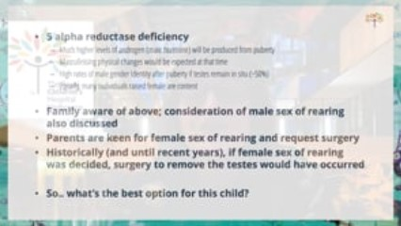
Professor Sonia Grover, Director of Gynaecology, Royal Children’s Hospital, Melbourne (1.00min)

Slide 18
7 Ethical Considerations in
Early Surgical Interventions
In the video clip, Professor Sonia Grover mentions seven ethical considerations that help guide treatment decision-making for children with differences of sex development. The considerations are:
Minimising physical risk to the child;
Maximising psychosocial wellbeing;
Preserving the potential for fertility;
Preserving or promoting the capacity to have satisfying sexual experiences;
Leaving options open for the future;
Respecting the parents’ wishes and beliefs;
Taking into account the views of the child.
Gillam LH, Hewitt JK, Warne GL., 2010
The aim of treatment decisions for DSD patients is to find the option that does the best job of balancing all these considerations.

Slide 19
Ethical principles underpinning
clinical decision-making
The seven ethical considerations used by Professor Grover and her team are grounded in general ethical principles commonly used in paediatrics:
Medical duties of beneficence and non-maleficence
Considering and balancing the physical and psychosocial benefits and harms of the proposed treatment pathway for both the child and parents.
(Beauchamp & Childress,7th ed. 2009)
Respect for parental autonomy in making decisions for their child
Recognition of parents as the child’s proxy decision-maker, respecting their wishes and moral authority to decide for their child. (Ross LF. 2019)
The child’s right to an open future
This can restrict what parents and others are allowed to do to children and what parents and others ought to provide children. (Feinberg, J. 1980)

Slide 20
Other Ethical Approaches
There are other ways to frame the ethical considerations for making decisions about early surgical intervention for DSDs;
Weisemann et al. (2010) Ethical Principles and Recommendations for the Medical Management of Differences of Sex Development (DSD)/Intersex in Children and Adolescents. European Journal of Pediatrics, Vol.169, pp.671-679
Weisemann et al. identify three key ethical principles in the management of DSD for children and adolescents. Notably, these differ in some ways and are fewer than the principles proposed by Gillam (2020).
    The wellbeing of the child and future adult.
2. To uphold the rights of children/adolescents to participate in decisions related to the management of their DSD condition.
3. To respect the family and parent-child relationships.

Slide 21
Other Ethical Approaches
Behrens, K.G. (2020) A principled ethical approach to intersex paediatric surgeries. BMC Med Ethics 21:108
In this article, Behrens identifies five ethical principles that he argues ought to inform ethics guidelines for surgical interventions in children with DSD;
Such surgeries should only be performed when there is strong evidence that they are beneficial and not harmful.
Surgeries should normally only be performed in cases of true medical necessity.
Surgeries should normally be delayed until such time as the intersex person is mature enough to assent to treatment or decide against it.
Conventional ethical requirements regarding truth telling apply equally to intersex children as to anyone else.
Where physicians or parents think that surgery is in the best interests of the child, the burden of proof lies with them.

Slide 22
Changes in practice
Ethical considerations and principles can help clinical decision-making in paediatric DSD cases.
However, explicit articulation of ethical principles is relatively recent in the healthcare context.
There is a longer tradition of practice wherein the treatments and their rationale are well established.
These practices and ideas have changed over time, as Dr O’Connell describes in the next clip…

Slide 23
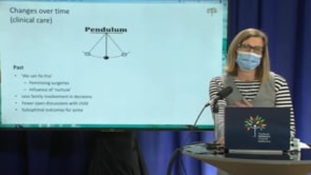
Dr Michele O’Connell, Paediatric Endocrinologist, Dept of Endocrinology and Diabetes, RCH Gender Service. (1.45mins)

Slide 24
Reasons for early surgical intervention
Medical practice has traditionally promoted early surgical intervention for the following reasons:
1. Appearance – likely the most controversial reason, ‘abnormal’ appearance of the genitalia or genitalia which does not align with the chosen sex of rearing (gender) or chromosomal sex of the child can be a basis for decisions around surgery.
2. Function – certain forms of DSD can impede bodily function, such as outlets for urine, and surgical interventions may be necessary or preferable to avoid further complications or even death.
3. Malignancy – certain forms of DSD carry an increased risk for malignant germ cell tumours. Surgical interventions in such cases are necessary to prevent tumours.

Slide 25
Reasons for early intervention: Appearance
“One of the aims of surgery is to make ambiguous external genitalia compatible with assigned gender.
Surgery can relieve parental distress and improve attachment between the child with DSD and the family.”
(Kim, K.S. and Kim, J. (2012)

Slide 26
Reasons for early intervention: Function
“Some of the aims of surgery are to prevent urinary obstruction or infections, preserving sexual and reproductive potentials, and maximizing anatomy to enhance sexual function.
It is important to inform the parents that a functional outcome is more important than a cosmetic outcome. Patients and parents should not be given unrealistic expectations about penile reconstruction.”
(Kim, K.S. and Kim, J. (2012)

Slide 27
Reasons for early intervention: Malignancy
“From a urologic perspective, the diagnosis of DSD raises concerns of tumor risk and treatment as well as future fertility preservation.
DSD patients are at increased risk for the development of testicular carcinoma in-situ (CIS) and germ cell tumors (GCT), including seminoma, non-seminoma, juvenile granulosa cell, gonadoblastoma, and dysgerminoma.
Other tumors are also of concern, including juvenile granulosa cell tumors (JGCTs) and tumors of congenital adrenal hyperplasia (CAH)
For example, Post-pubertal complete androgen insensitivity syndrome (AIS) patients remain prone to tumor development if the testes remain in the abdomen. Estimates of the risk of GCT in partial AIS for untreated undescended testes may be as high as 50%.”
(Kathrins, M., & Kolon, T. F. (2016)

Slide 28
Changes in practice
More recently, there have been changes to the clinical management of children
born with intersex conditions, as Dr O’Connell explains…

Slide 29
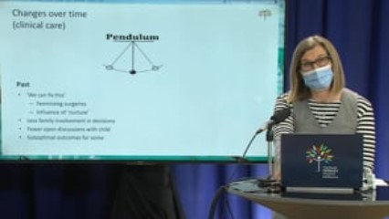
Dr Michele O’Connell, Paediatric Endocrinologist, Dept of Endocrinology and Diabetes, RCH Gender Service (45secs)

Slide 30
Changes in practice
This shift in the clinical management of children with DSD, including a more multi-disciplinary approach, is a global trend.
A number of international consensus documents have detailed these changes, and one country has enacted world-first legal protections for intersex individuals…

Slide 31
International perspectives on clinical management of Intersex conditions
The International Consensus Conference on Intersex Conditions, Chicago, 2005 stipulated:
Optimal clinical management of individuals with DSD should comprise the following:
gender assignment must be avoided before expert evaluation in newborns;
evaluation and long-term management must be carried out at a centre with an experienced multidisciplinary team;
all individuals should receive a gender assignment;
open communication with patients and families is essential and participation in decision making is encouraged;
patient and family concerns should be respected and addressed in strict confidence. Lee PA, Houk CP, Ahmed SF, Hughes IA 2006

Slide 32
Chicago Consensus Update 2016
10 years later, the Chicago Consensus Statement was revisited and provides an update on perceptions, approach to patients with DSD and their care.
  The goal of patient care is focused upon the best possible quality of life (QoL).
  It was noted that the field of DSD is continuously developing.
  Open and on-going communication with patients and parents must involve full disclosure, with the recognition that, while DSD conditions are life-long, enhancement of the best possible outcome improves QoL.
  The evolution of diagnosis and care continues, while it is still impossible to predict gender development in an individual case with certainty. Such decisions and decisions regarding surgery during infancy that alters external genital anatomy or removes germ cells continue to carry risk.
Lee P, A, Nordenström A, Houk C, et al 2016

Slide 33
Malta Intersex Protection Legislation- 2015
In April 2015, Malta became the first country in the world to enact legislative protections of intersex individuals.
The Gender Identity Gender Expression and Sex Characteristics Act recognises a right to bodily integrity and physical autonomy.
The laws protect intersex infants and children from non-consensual medical interventions and cosmetic changes to sex characteristics in childhood, where such treatment could be deferred until the person being treated can provide informed consent. It also provides protection from discrimination.
(Act XI of 2015 - Gender Identity, Gender Expression and Sex Characteristics Act, 2015. Government Gazette of Malta. No. 19,410 – 14.04.2015)

Slide 34
Recently, there have been calls for legislated protections for intersex individuals in Australia, as Dr O’Connell explains…

Slide 35
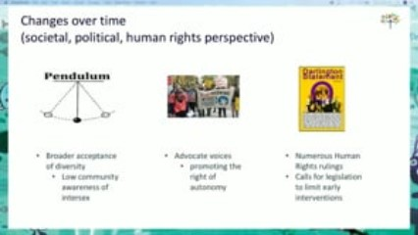
Dr Michele O’Connell, Paediatric Endocrinologist, Dept of Endocrinology and Diabetes, RCH Gender Service. (30secs)

Slide 36
Resources
Darlington Statement: https://darlington.org.au/statement/
A joint consensus statement from Australian and Aotearoa/New Zealand intersex community organisations and independent advocates. The document focuses on human rights and legal reform, health and wellbeing, peer support, education, awareness, and employment.
(i) am equal: https://www2.health.vic.gov.au/about/publications/factsheets/i-am-equal
This document sketches out the Victorian government’s aim to increase knowledge and awareness of intersex variations and to support informed decisions and quality practice; ensure health and LGBTIQ+ services and programs are inclusive of intersex variations and support the establishment of specific intersex health and wellbeing services; and to improve the care and treatment of people, especially infants and children, with intersex variations.

Slide 37
Resources
ACT regulatory options:
https://www.cmtedd.act.gov.au/__data/assets/pdf_file/0011/1778402/Intersex-project-options-stakeholder-discussion-paper.pdf
This paper outlines the ACT’s framework to protect the rights of people with intersex variations in medical settings.

Slide 38
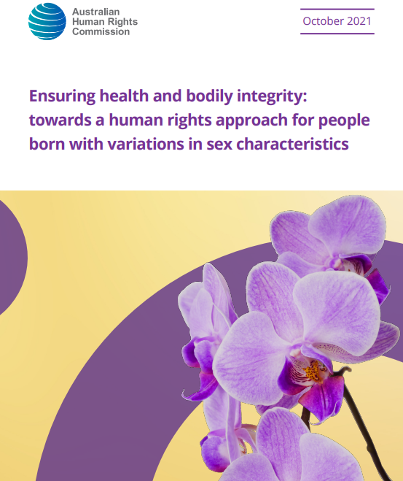
Resources
Since the presentation at the CBC Conference in September 2021, the Australian Human Rights Commission has published a report recommending a human rights-based approach to people born with DSD.
The AHRC report considers how best to protect people born with DSD in the context of medical interventions and personal consent. It calls for any medically unnecessary medical intervention in a child with DSD who cannot consent to the intervention to be punishable as a criminal offence. It proposes five supporting principles based in human rights language:
Bodily Integrity
Children’s Agency
Precautionary Principle
Medical Necessity
Independent Oversight

Slide 39
There have been many state-level, national and international calls for legislative change to enshrine protections for intersex individuals, predominantly against non-medically indicated cosmetic procedures altering genitalia.
The Australian human rights proposal discussed on the previous slide proposes a legal requirement for mandatory deferral of surgery until a child can provide informed consent themselves.
In the next clip, Dr O’Connell discusses the pro’s and con’s of deferring surgery, and discusses the benefits and potential harms of legislating prohibitions to surgery until a child is old enough to decide.

Slide 40

Dr Michele O’Connell, Paediatric Endocrinologist, Dept of Endocrinology and Diabetes, RCH Gender Service (1.57Mins)

Slide 41
Conclusion
As this presentation has demonstrated, the issue of early surgical intervention for children with DSDs is, and will continue to be, an ethically challenging and complex area of paediatric healthcare.
Key questions to consider in these cases include;
Should parents have a say in the decision when the child is in the newborn stage?
Should parents and doctors be able to make decisions without government regulation or involvement?
Should all decisions related to surgery be delayed until the child can provide informed consent? Or should they be decided on a case-by-case basis?
What age can a child meaningfully consent to intersex surgery?

Slide 42
References
To know more about the ethics of deferring surgery in children with DSD, here is a curated list of references contained within this presentation.
General Information Concerning DSD:
Hutson, John M., et al., eds. Disorders| Differences of Sex Development: An Integrated Approach to Management. Springer Nature, 2020.
St Louis Children’s Hospital, Differences of Sex Development.
https://www.stlouischildrens.org/conditions-treatments/differences-sex-development
5-Alpha Reductase Deficiency:
https://pie.med.utoronto.ca/htbw/module.html?module=sex-development
Long term outcomes:
Costa, E., Domenice, S. & Sircili, M. H et al. (2012). DSD Due to 5α-Reductase 2 Deficiency - from Diagnosis to Long Term Outcome. Seminars in reproductive medicine. 30. 427-31.

Slide 43
Glossary
Adrenal hormone replacement – the medical replacement of hormones when the adrenal glands do not produce them.
Congenital Adrenal hyperplasia – a rare disorder characterised by a deficiency in one of the enzymes required to produce certain hormones. The most prevalent cause of DSD among people with XX chromosomes.
Non-binary – a gender identity wherein a person identifies beyond binary genders of man or woman. This is not a form of DSD.
Chromosomal – relating to the chromosomes. A person with a chromosomal abnormality may be missing a chromosome from a pair or have more than two chromosomes.
Gonadal – relating to the gonads. See gonads.
Gonads – the primary reproductive organs. In females these are the ovaries and in males these are the testes. These organs are responsible for fertility, as well as secreting hormones. This term is sometimes used synonymously with testes.

Slide 44
Glossary
Hypospadias – A form of DSD occurring when the opening of the penis is located on the underside rather than the tip.
Karyotype – an individual’s collection of chromosomes.
Neonate – a newly born baby.
Psychosocial – the combined influence of psychological factors and the surrounding social environment on an individual’s physical and mental wellbeing.
Autonomy – commonly defined in Western medicine and ethics as the capacity to make an informed, uncoerced decision.
Gillick competence – a term used in medical law to determine when a child is able to make an autonomous decision (and provide valid consent) about their own medical treatment without the need for parental permission or knowledge.

Slide 45
Glossary
46, XY – as a form of DSD, this occurs when an individual has an X and Y chromosome in each cell (a pattern normally found in genetic males), but has genitalia that is not clearly male or female.
Sex of rearing – the gender (often used interchangeably with ‘sex’) a child is treated as by their family and others whilst growing up. While many children with DSD identify with the gender of rearing as adults, others may come to identify differently.

